Slide 1

Data Presentation
Data-Driven Marketing Performance Analysis & Strategic Insights

Slide 2
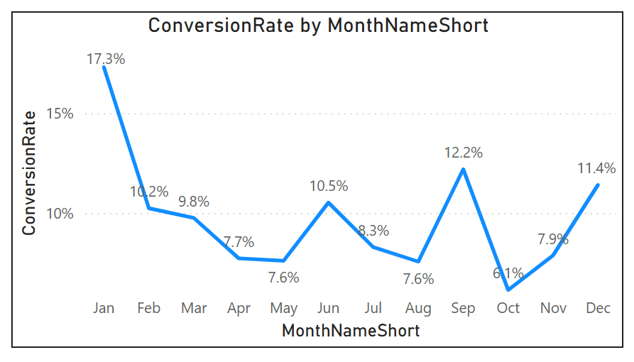
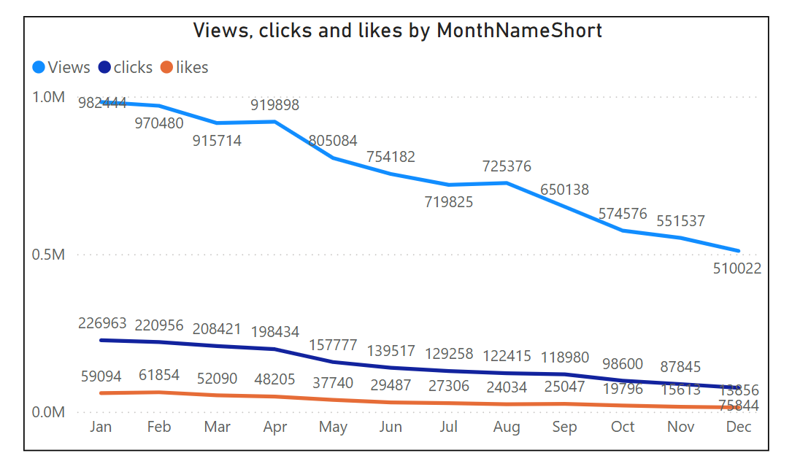
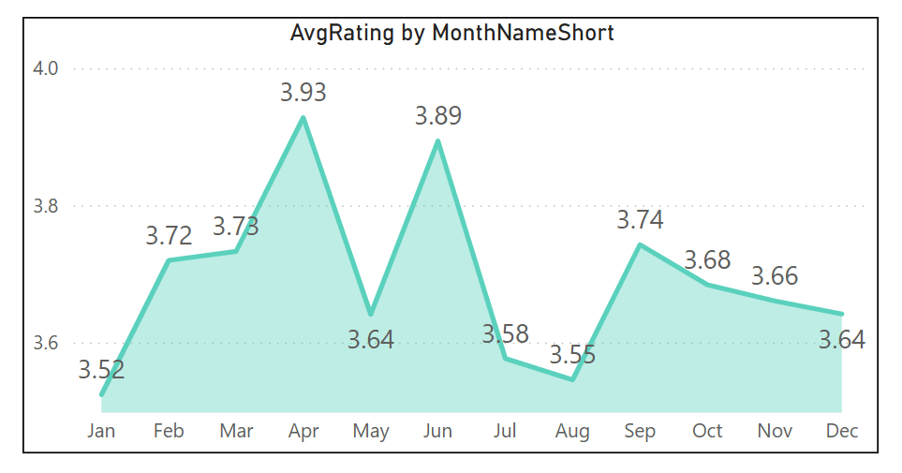
✅ Insights Summary
Conversion Performance
  Conversion rate dropped to 6.1% in October
  Strong recovery to 11.4% in December, reflecting improved campaign effectiveness
  Customer Engagement
  Overall social media engagement declined through the year, especially views
  Despite lower reach, CTR remains strong at 15.37%, showing high intent from engaged users
  Customer Feedback
  Average customer rating stable at ~3.7 (slightly below 4.0 benchmark)
  Products rated below 3.5 require priority action to improve satisfaction and reduce churn risk
🎯 Key Takeaways
  Marketing efforts need stronger reach & engagement strategy
  High CTR indicates relevant messaging and quality audience targeting
  Focus on enhancing customer experience & low-rated product lines

Slide 3
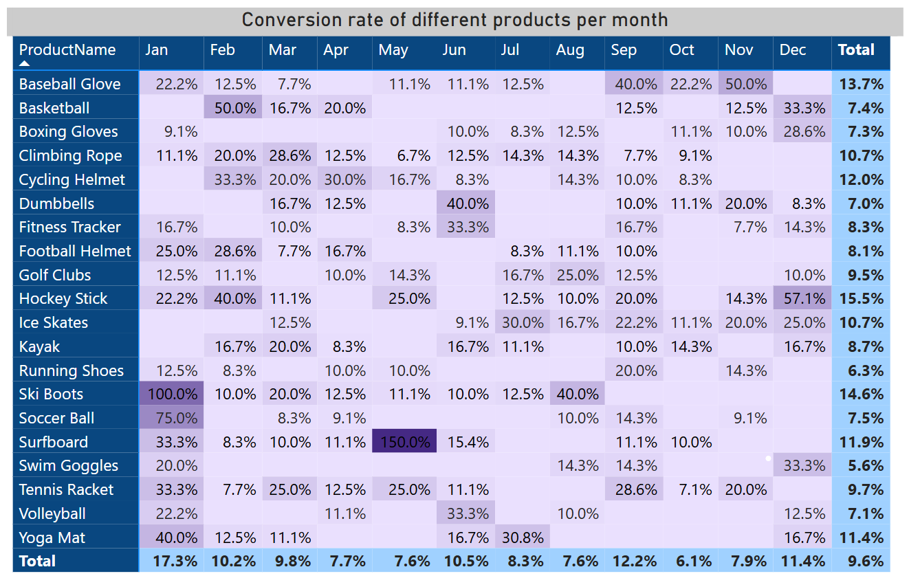
✅ Key Insights
📉 Conversion Trend
  Conversion rate dipped to 6.1% in October, indicating campaign fatigue or reduced audience interest
  Strong rebound to 11.4% in December, driven by seasonal demand and improved targeting
👥 Customer Engagement
  Overall engagement declined across the year, with a noticeable drop in content views
  Despite lower reach, CTR remains strong at 15.37%, showing content is relevant to engaged users
⭐ Customer Feedback
  Average rating stable at ~3.7, slightly below the 4.0 quality benchmark
  Products rated below 3.5 require priority improvements to elevate customer satisfaction
🎯 Takeaways
  Strengthen awareness & engagement strategy to improve top-funnel performance
  Maintain effective messaging while expanding reach & targeting
  Focus on CX and improve low-rated product categories

Slide 4
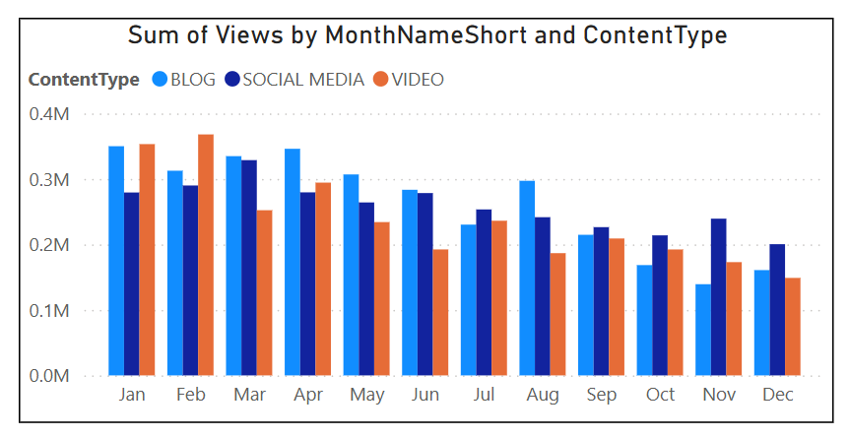
✅ Strategic Recommendations
🧭 Boost Customer Acquisition
  Increase social media reach through targeted paid campaigns & influencer partnerships
  Leverage remarketing to re-engage users who showed intent but didn’t convert
  Continuously A/B test creatives, CTAs, and landing pages to improve conversion journey
🎯 Improve Engagement & Click Efficiency
  Refresh content strategy focusing on short-form, interactive, and value-driven content
  Optimize posting frequency & timing to maximize reach
  Strengthen audience targeting & personalization to maintain high CTR at scale
⭐ Enhance Customer Experience & Satisfaction
  Focus on products rated below 3.5 — identify pain points & improve quality/service
  Implement customer feedback loop to track and address specific concerns
  Introduce loyalty programs or CX initiatives to turn users into advocates
🎯 Expected Outcomes
  ↑ Customer acquisition & brand visibility
  ↑ Engagement & sustained CTR performance
  ↑ Customer satisfaction & repeat purchase behavior

Slide 5
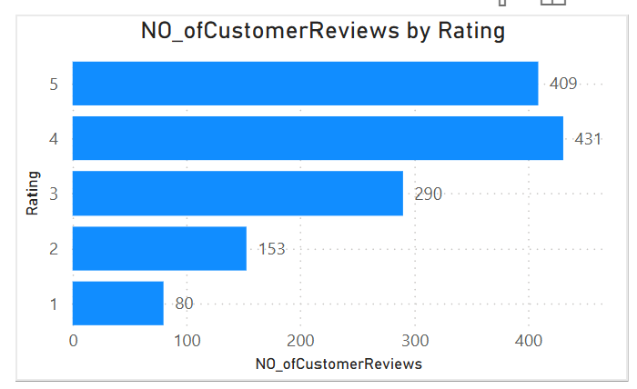
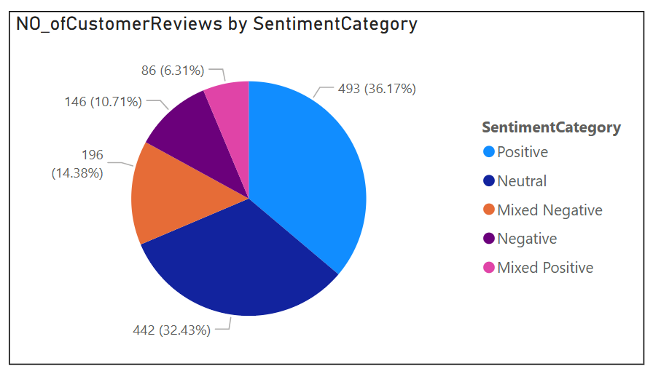
✅ Social Media Performance Analysis
📊 Reach & Engagement Trend
  Overall reach gradually declined over the months, indicating reduced content visibility & platform algorithm traction
  Engagement metrics such as likes & views also followed a similar downward pattern
  Clicks remained relatively stable, showing the audience still finds the content relevant when reached
🔎 Efficiency Metrics
  Click-Through Rate (CTR) remained healthy, despite reduced views
  This indicates content is valuable and persuasive to the right audience
  Challenge lies more in increasing visibility, not content quality
📈 Platform-Level Insights
  Performance varied across platforms, likely due to audience distribution and content-type suitability
  Platforms with high intent users delivered better conversion potential even with lower volumes
🎯 Key Takeaways
  Strengthen content reach strategy (frequency, timing, hashtags, collabs)
  Maintain focus on creative quality to retain high CTR
  Tailor posting format per platform (short-form, reels, carousels)

Slide 6
✅ Customer Feedback Insights
🎯 Goal
✅ Strategic Action Plan
Increase Conversion Rates
  Goal: Understand conversion bottlenecks and improve the funnel efficiency
  Insight: Conversion dropped mid-period but rebounded strongly, indicating opportunities to optimize targeting, landing experience, and retargeting flows
Enhance Customer Engagement
  Goal: Identify content formats and strategies that maximize interaction and audience stickiness
  Insight: Engagement and reach declined over time, but CTR remained high, showing that content quality is strong — distribution & audience reach need strengthening
Improve Customer Experience & Ratings
  Goal: Address recurring issues and elevate product/service quality to push ratings above 4.0
  Insight: Average rating held stable around ~3.7, but products below 3.5 highlight clear areas for product refinement, delivery improvement, and better support touchpoints
Strengthen Feedback-to-Action Loop
  Goal: Build a structured system to continuously capture, analyze, and act on customer feedback
  Insight: Repeated complaint themes across lower-rated items signal the need for systematic monitoring, escalation, and quality control processes
📈 Expected Impact
⭐ Significant improvement in customer satisfaction, with average ratings targeted to increase from ~3.7 to 4.0+, reflecting enhanced product quality and service experience.
🔁 Higher repeat purchase rates and stronger customer retention, driven by better product performance, improved post-purchase experience, and trust-building initiatives.
📣 Enhanced brand perception and positive word-of-mouth, as satisfied customers share feedback and contribute to improved online sentiment and recommendation behavior.
📉 Reduction in product complaints, returns, and support tickets, leading to lower operational friction, reduced resolution time, and improved internal efficiency.
🚀 Sustainable long-term growth foundation, supported by a continuous feedback loop, proactive issue resolution, and customer-centric product improvements.

